Slide 1
AutoCodeRover: Autonomous Program Improvement
Yuntong Zhang, Haifeng Ruan, Zhiyu Fan, Abhik Roychoudhury
Presenter: Nhat Minh Le – 40323412

Slide 2
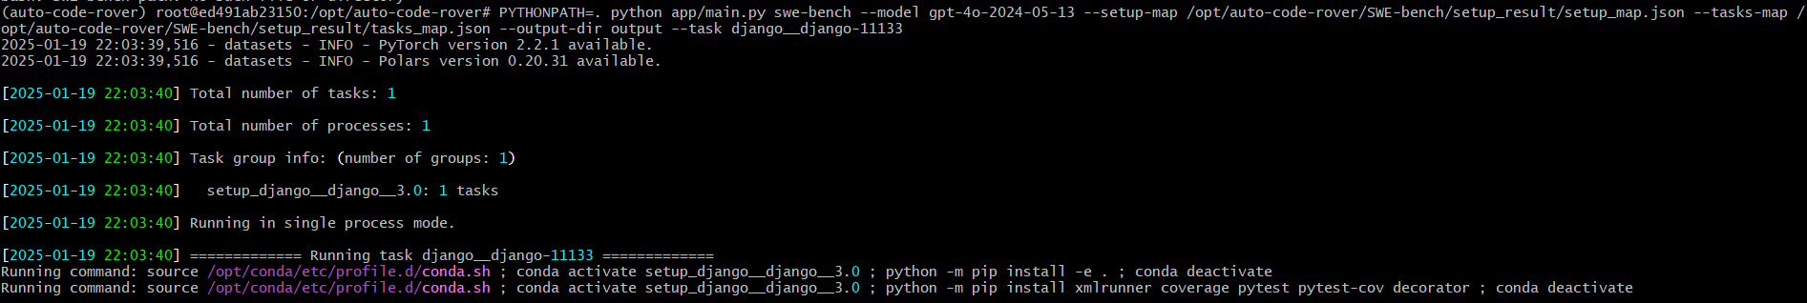
1 Issues: django-11133 ( Single Task)

Slide 3
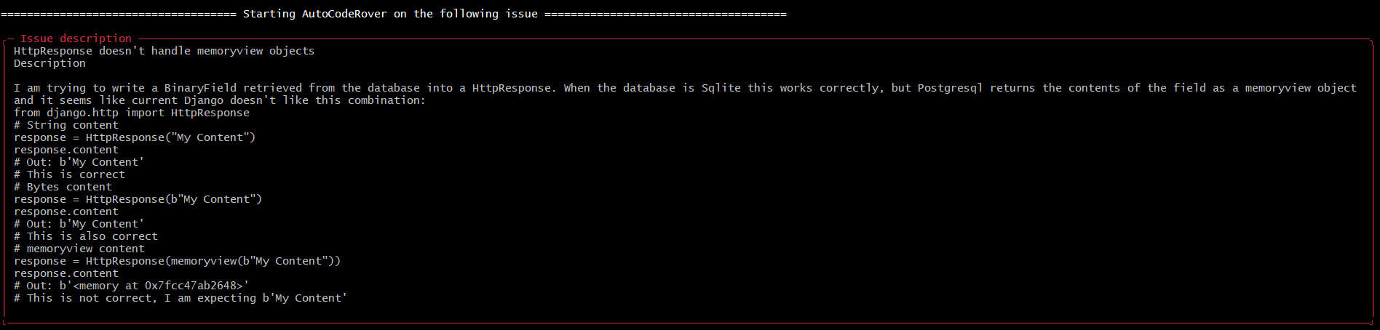

Slide 4
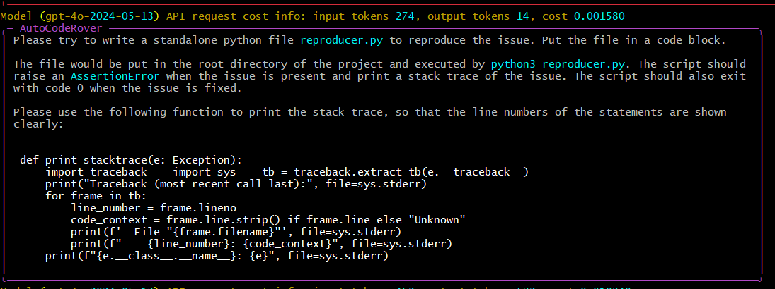

Slide 5
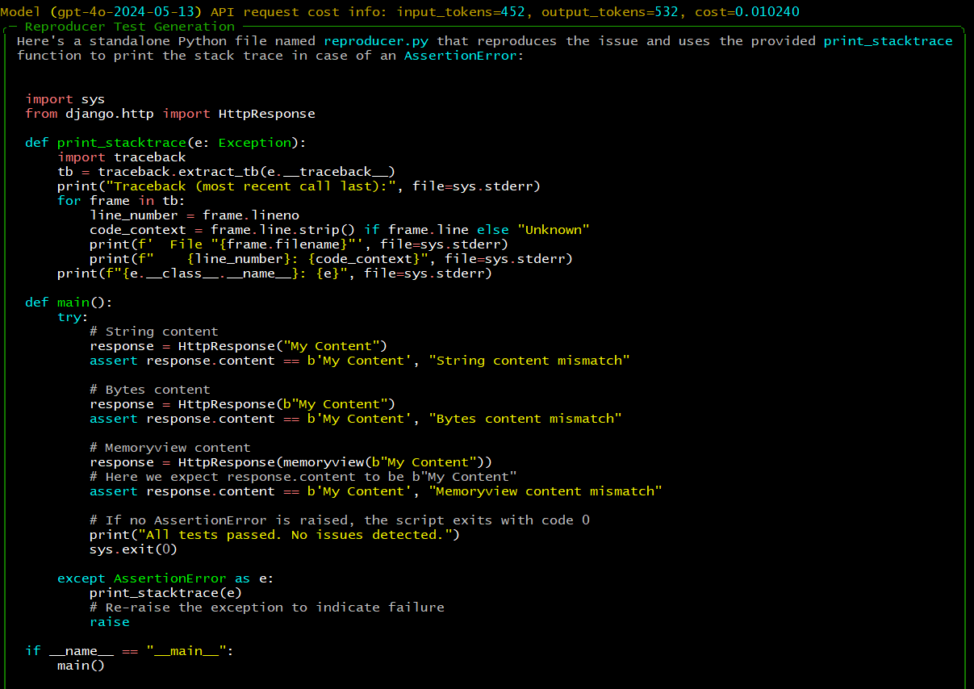

Slide 6
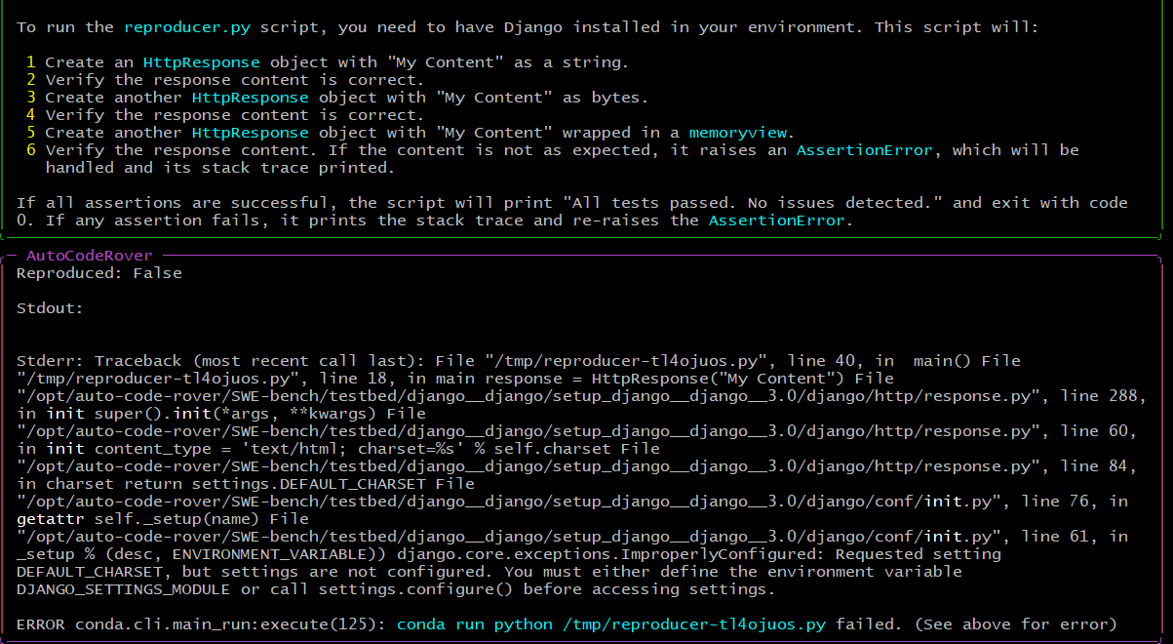

Slide 7
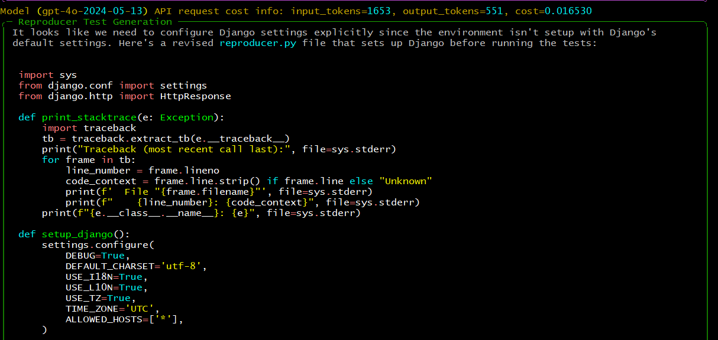

Slide 8
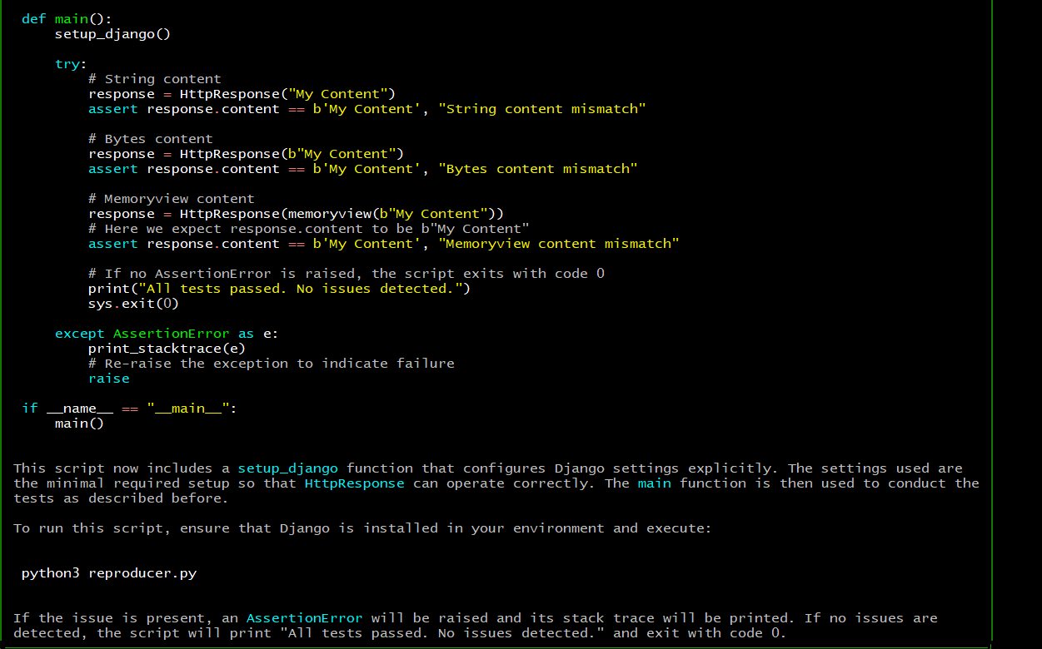

Slide 9
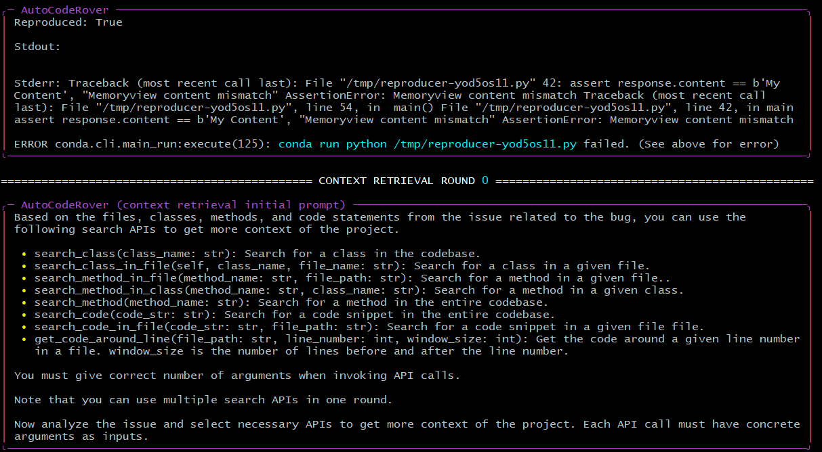

Slide 10
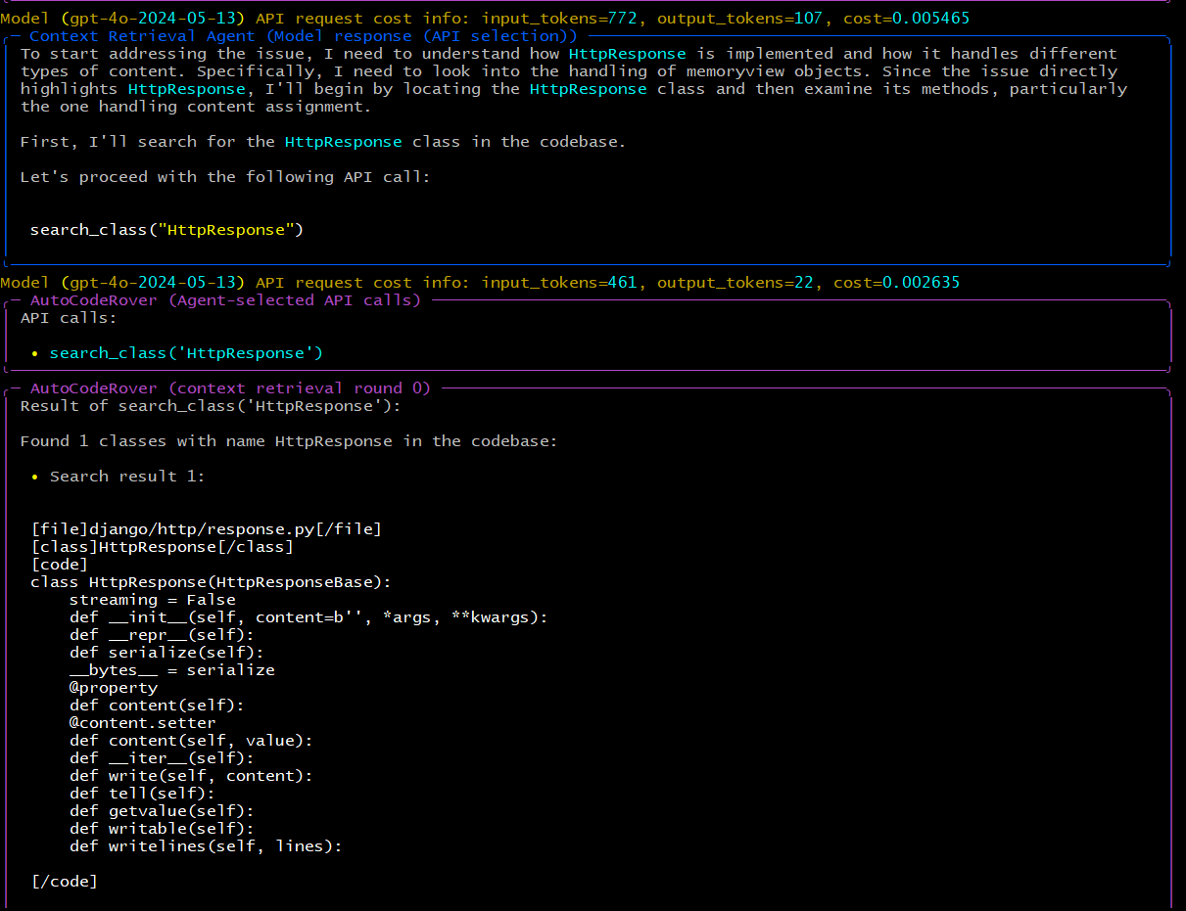

Slide 11
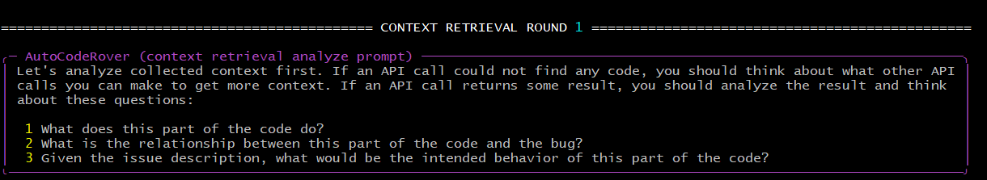

Slide 12
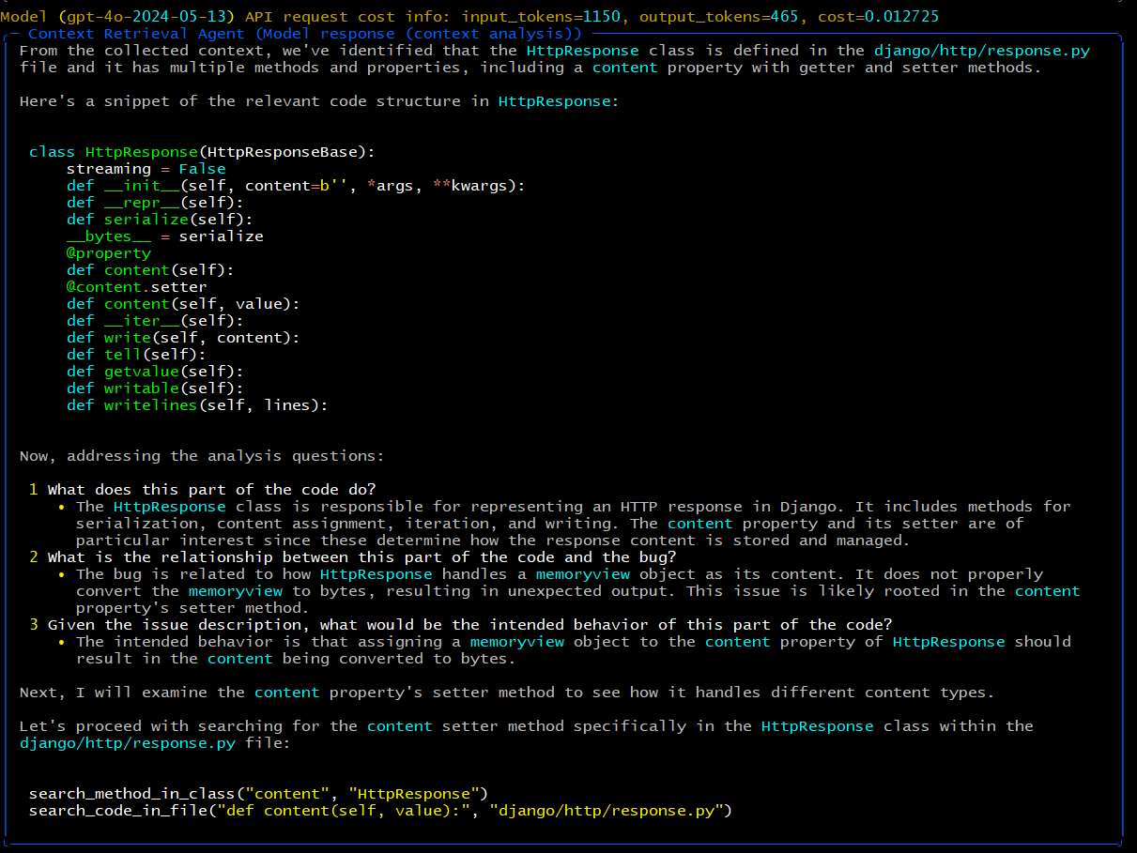

Slide 13
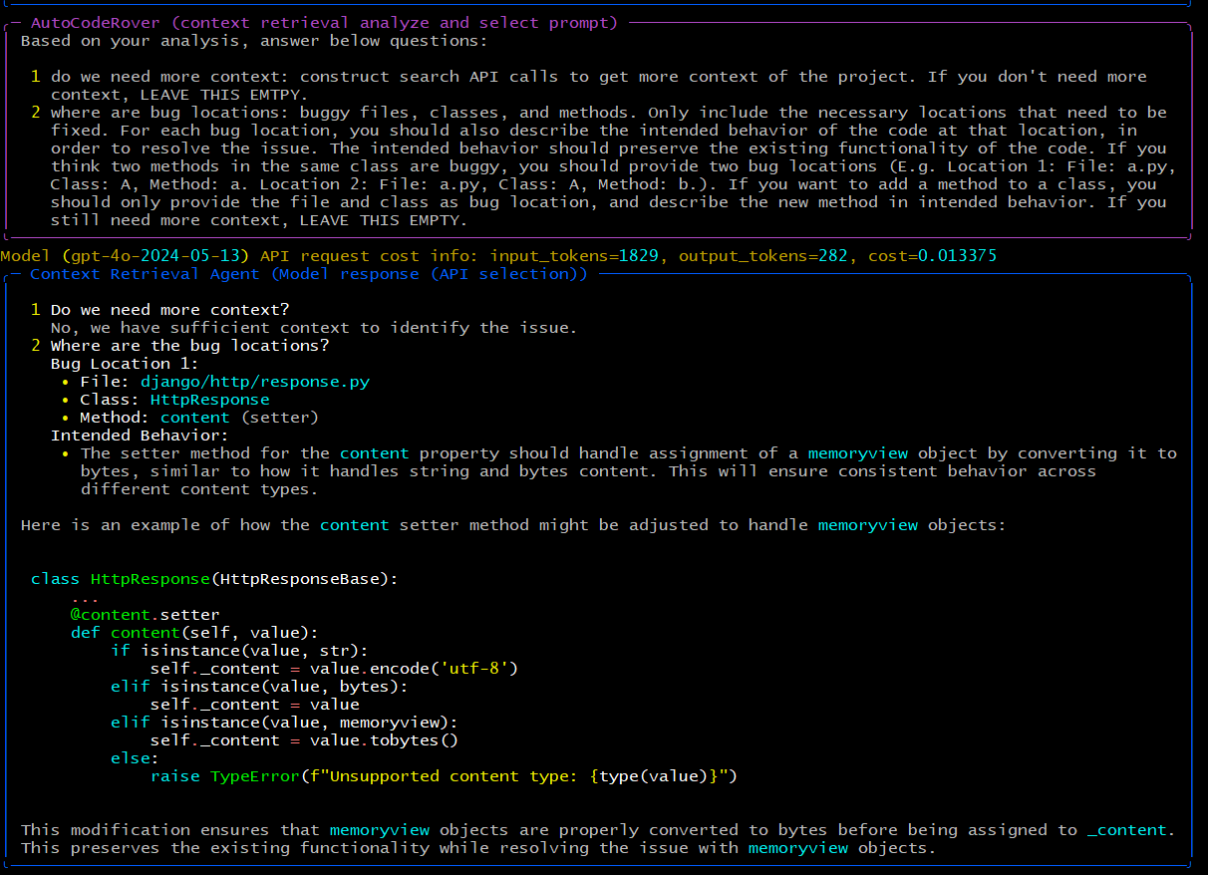

Slide 14
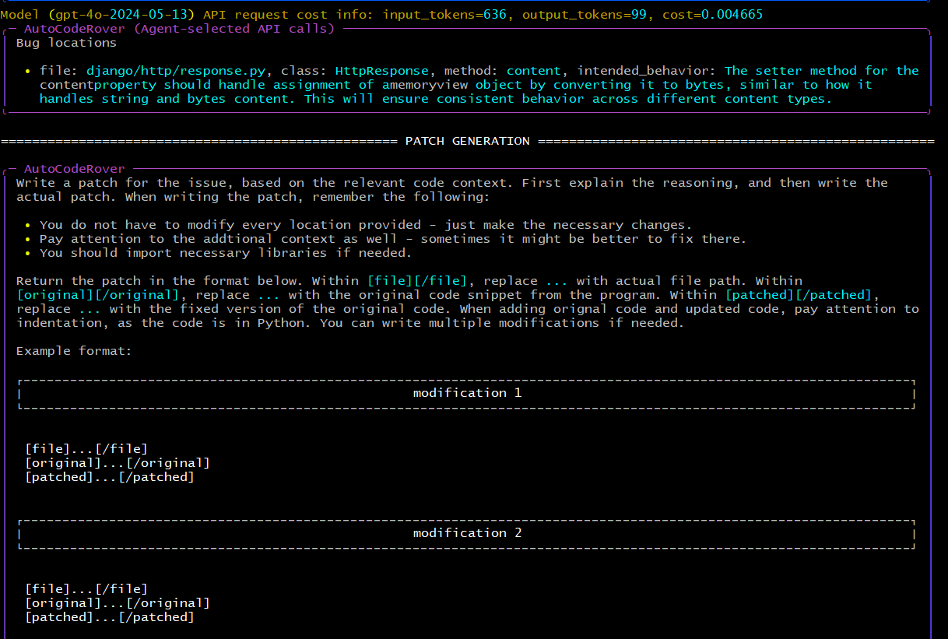

Slide 15
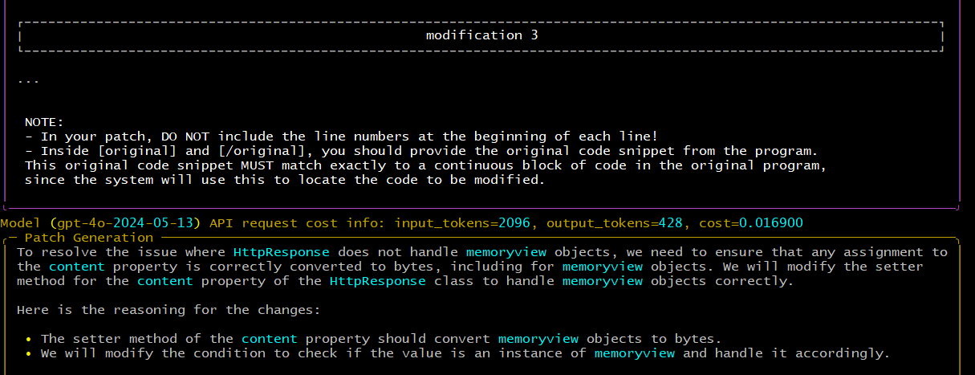

Slide 16
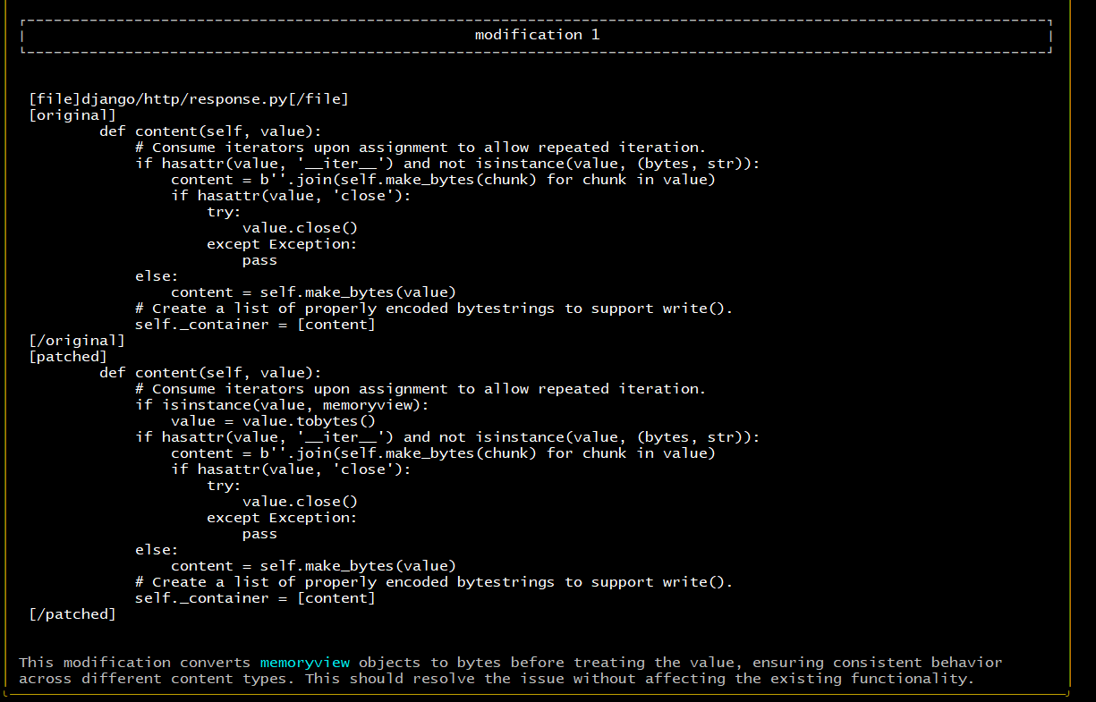

Slide 17
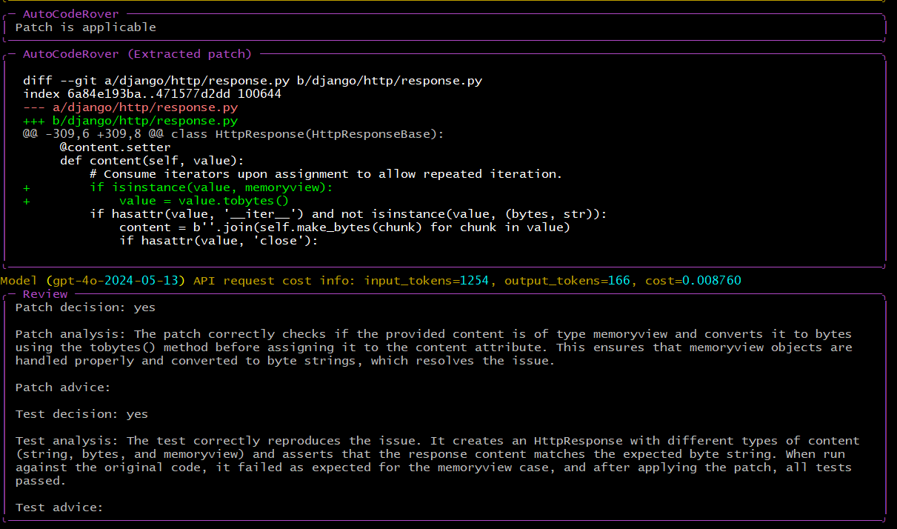

Slide 18
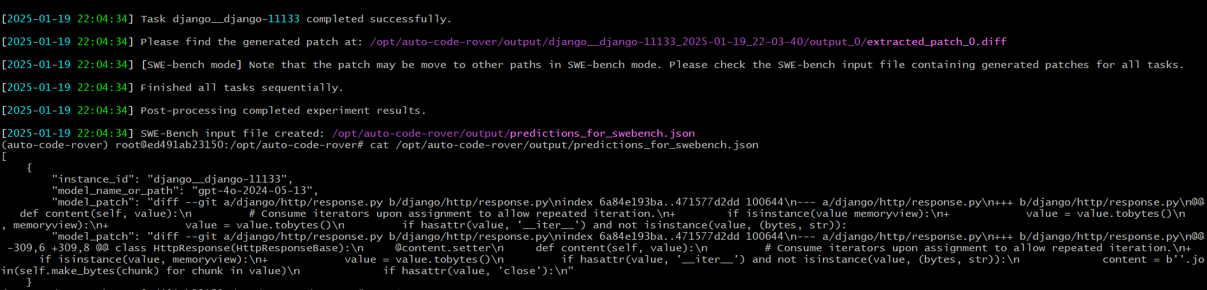

Slide 19
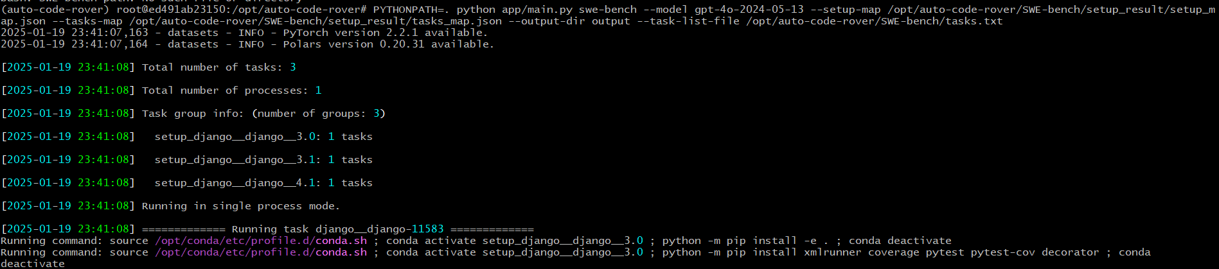
3 Issues: django-15388, 12125, 11583

Slide 20
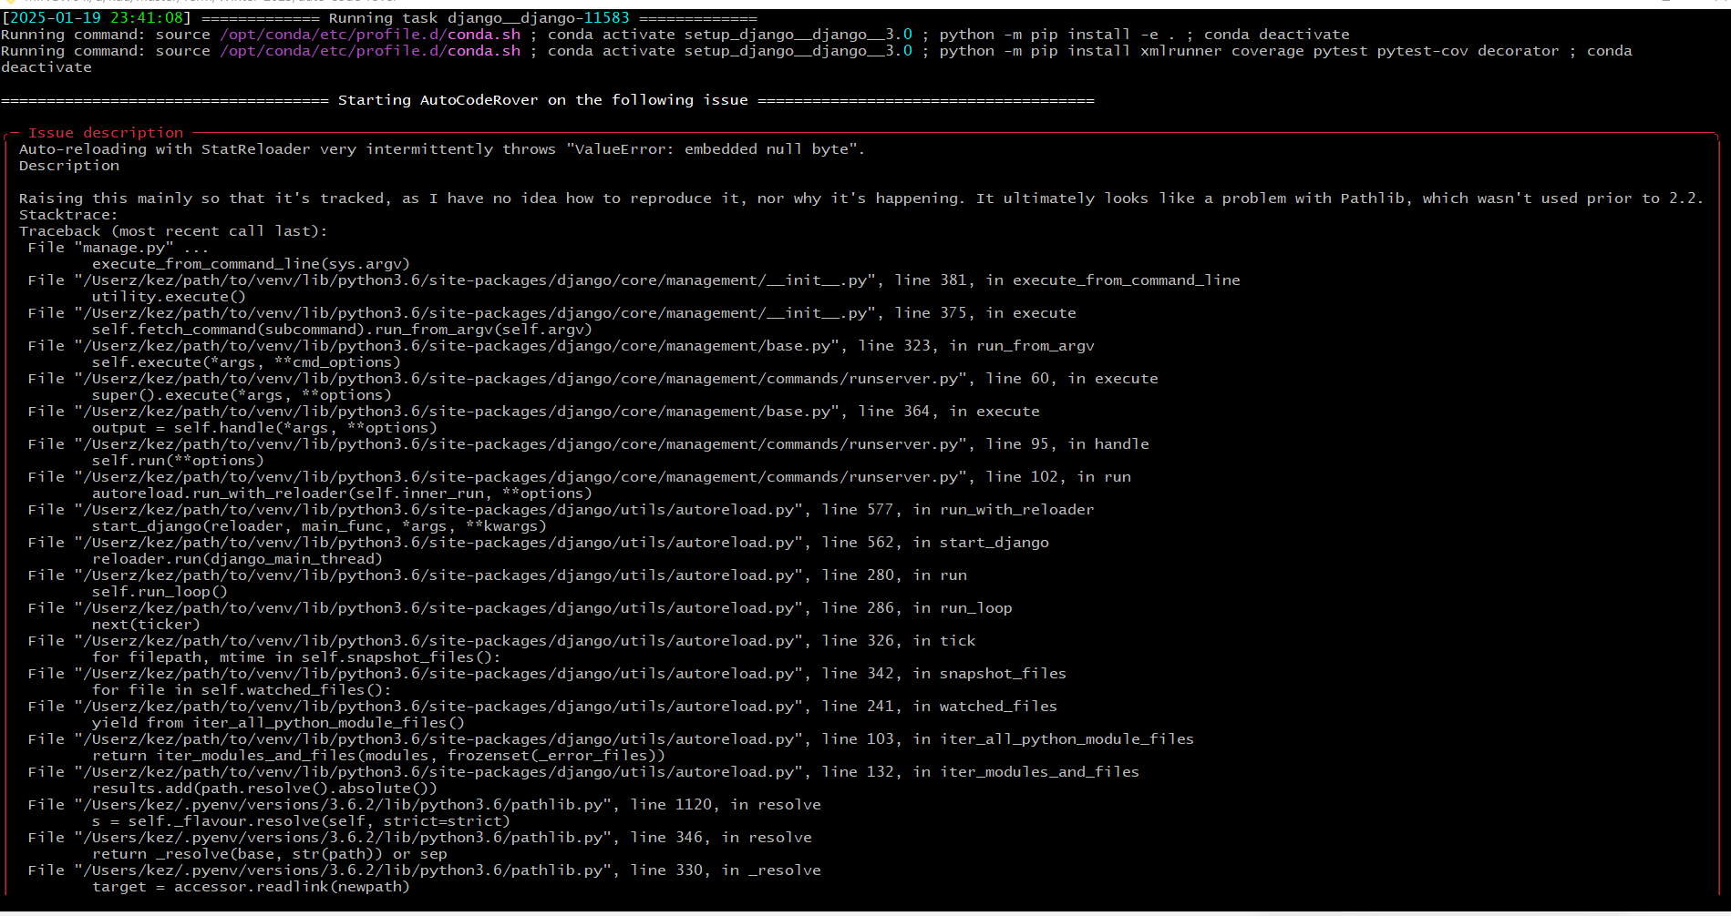
Issue 1: django-11583

Slide 21
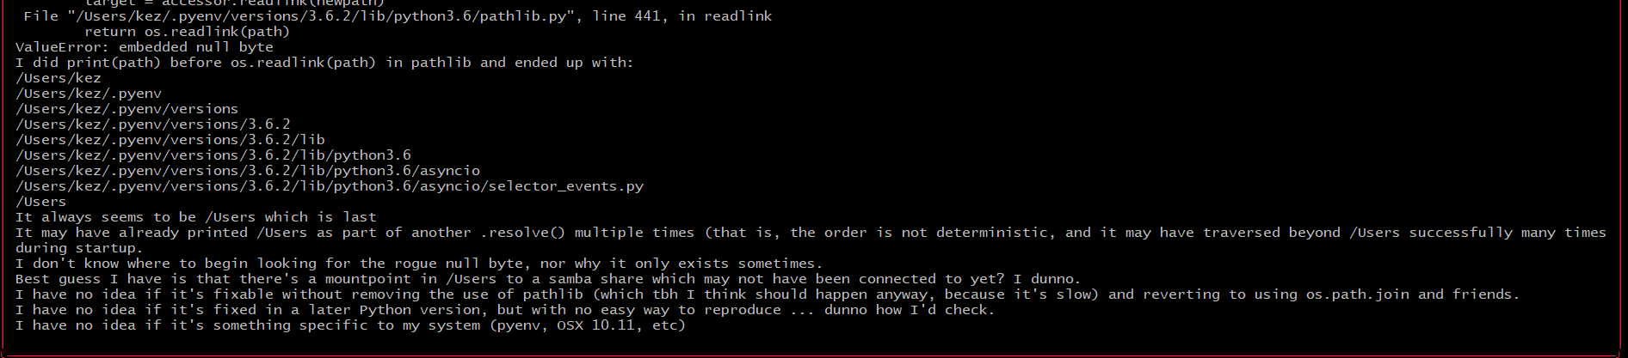
Issue 1: django-11583

Slide 22
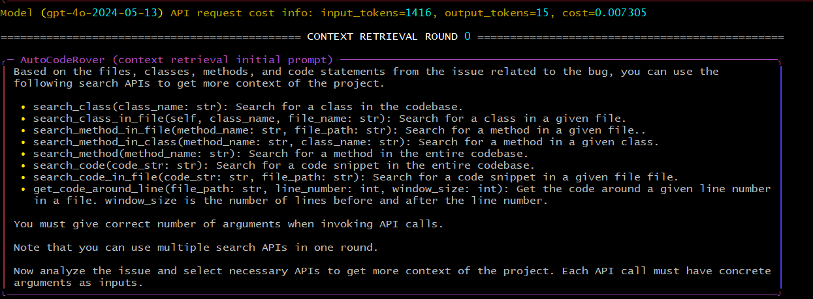
Issue 1: django-11583

Slide 23
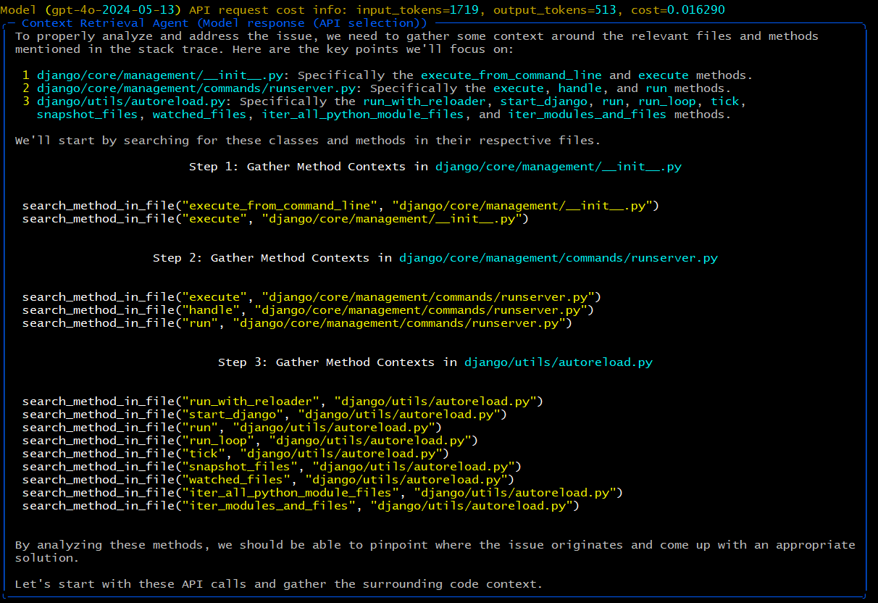
Issue 1: django-11583

Slide 24
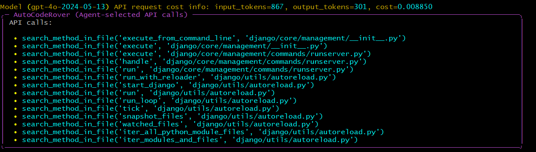
Issue 1: django-11583

Slide 25
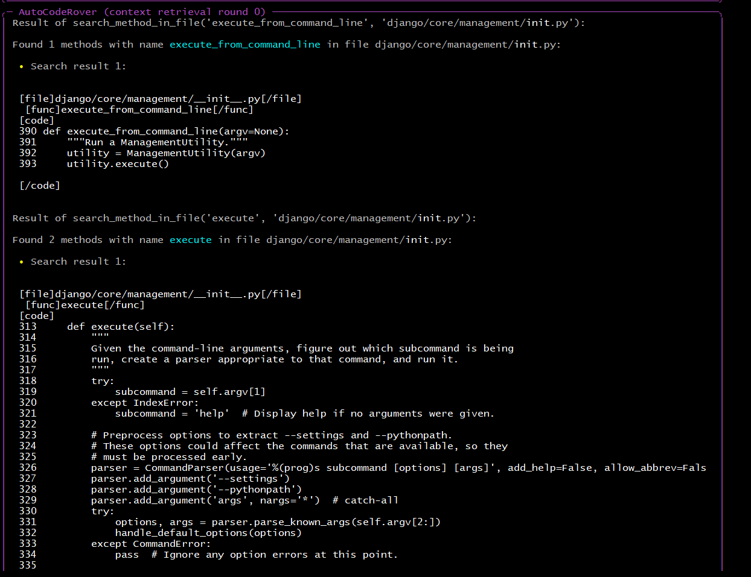
Issue 1: django-11583

Slide 26
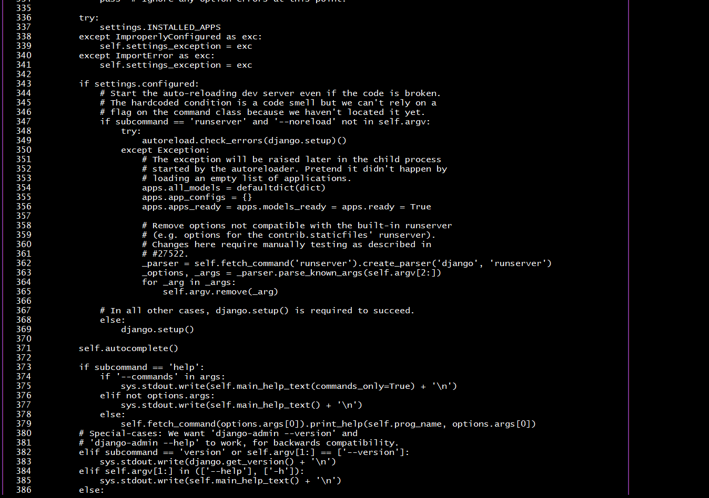

Slide 27
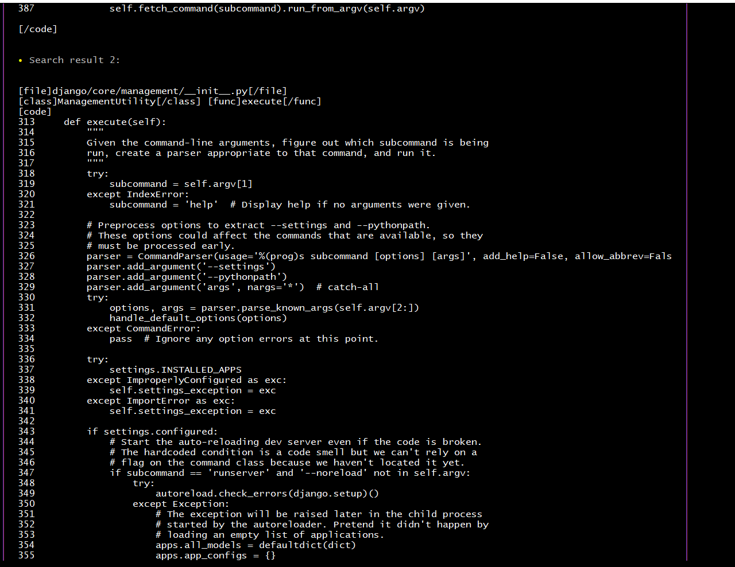

Slide 28
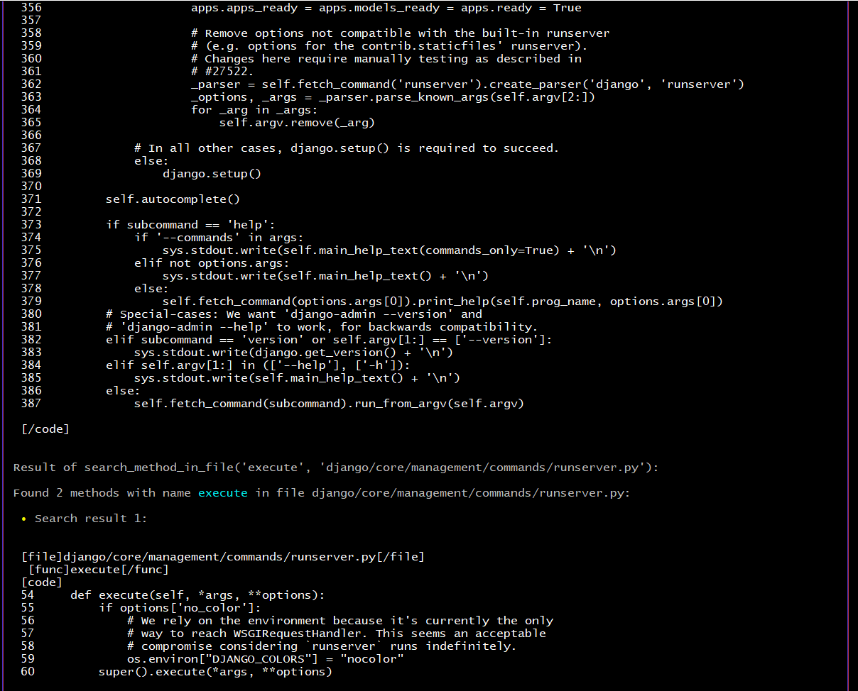

Slide 29
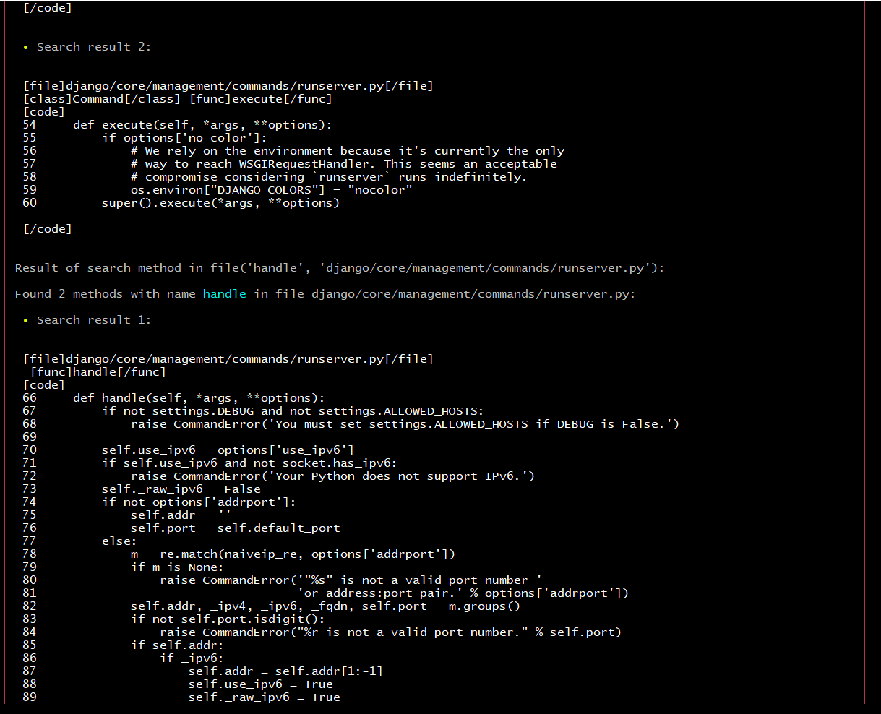

Slide 30
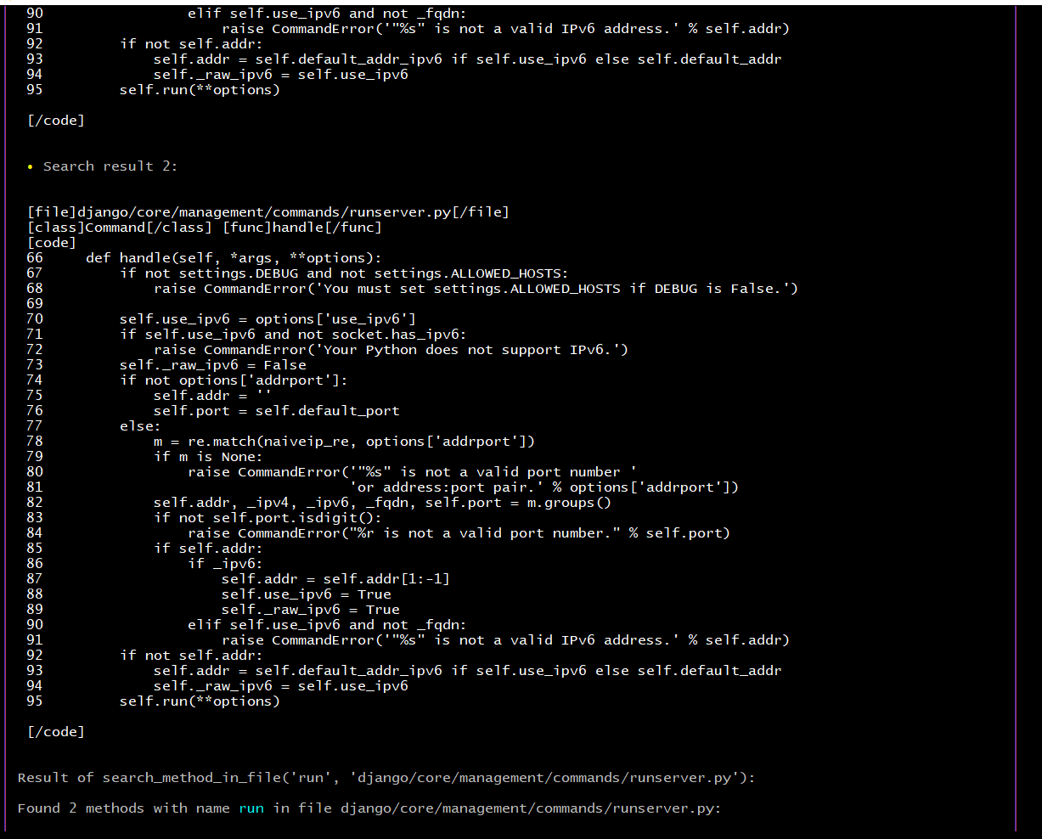

Slide 31
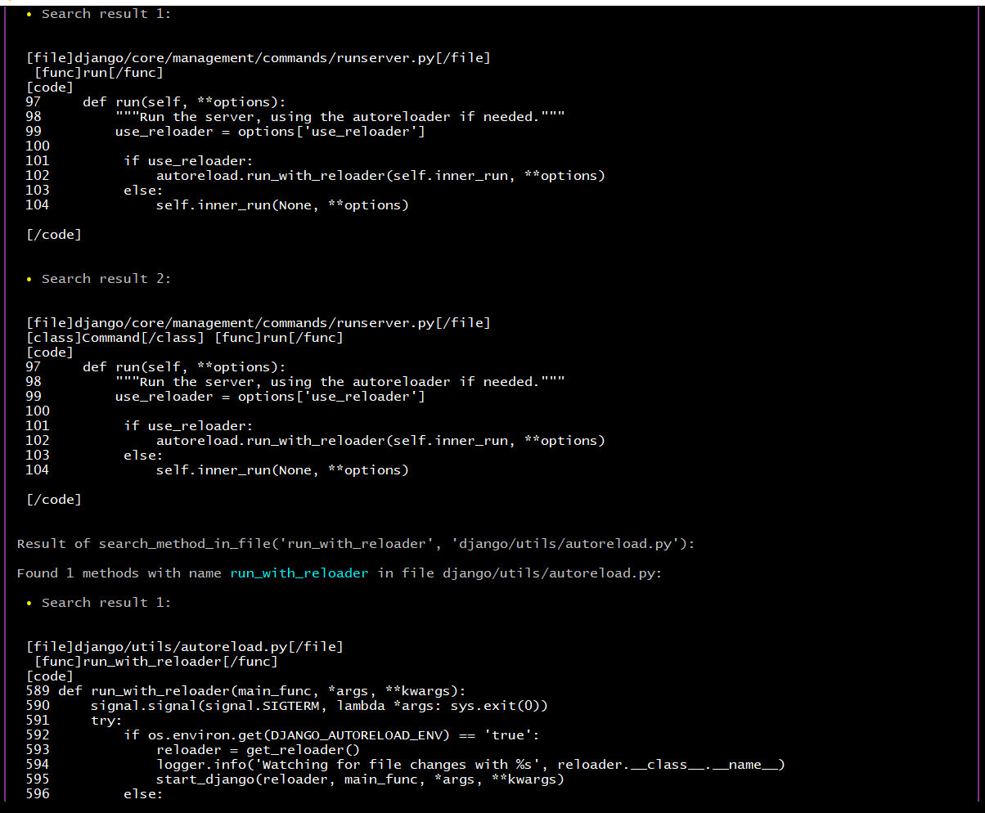

Slide 32
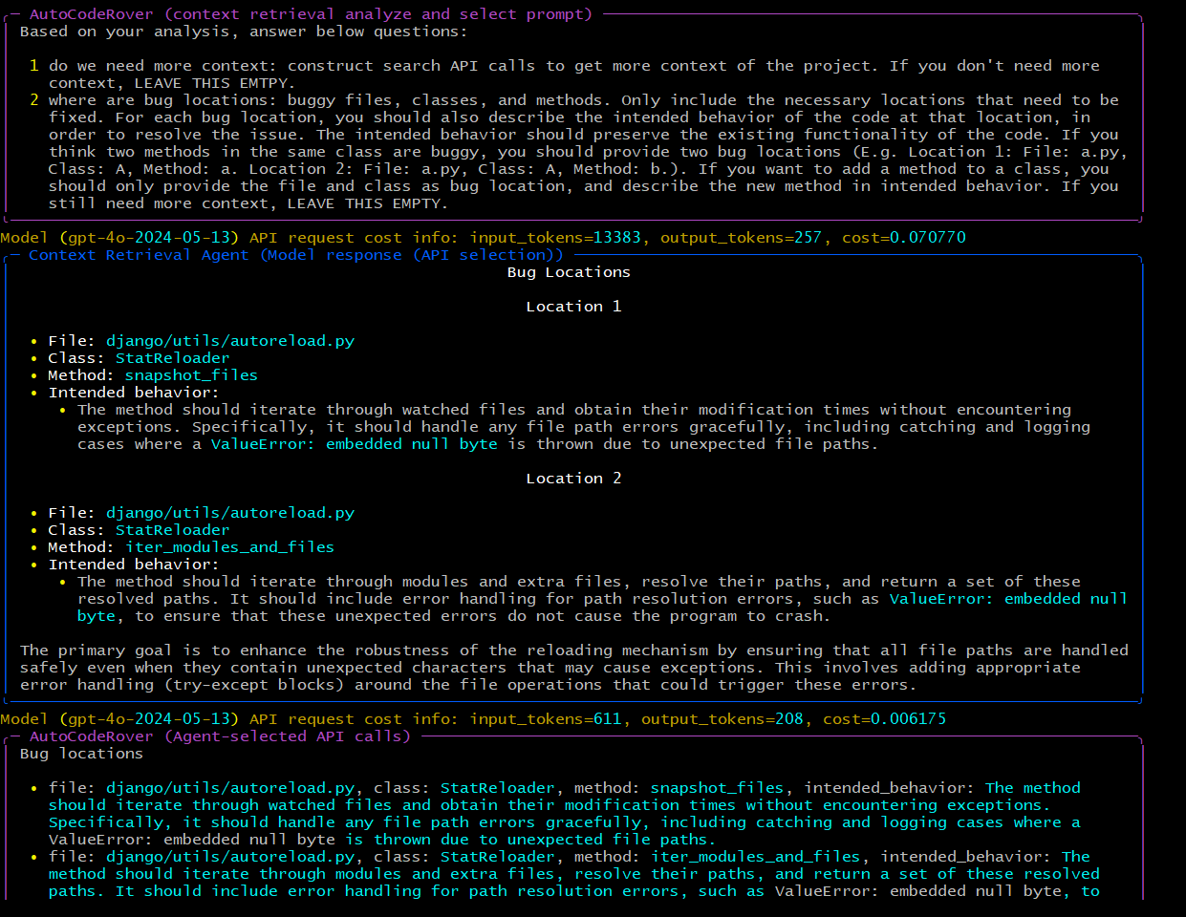

Slide 33
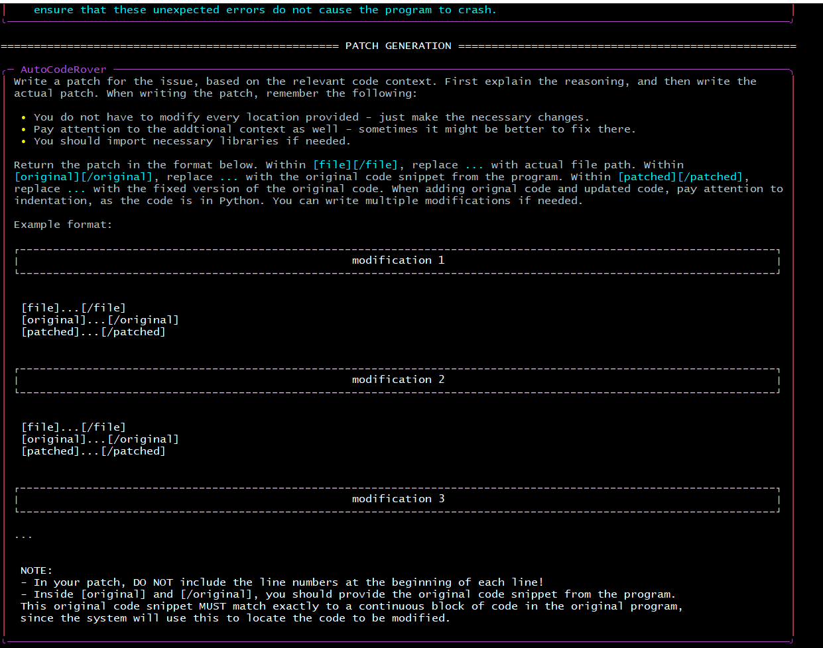

Slide 34
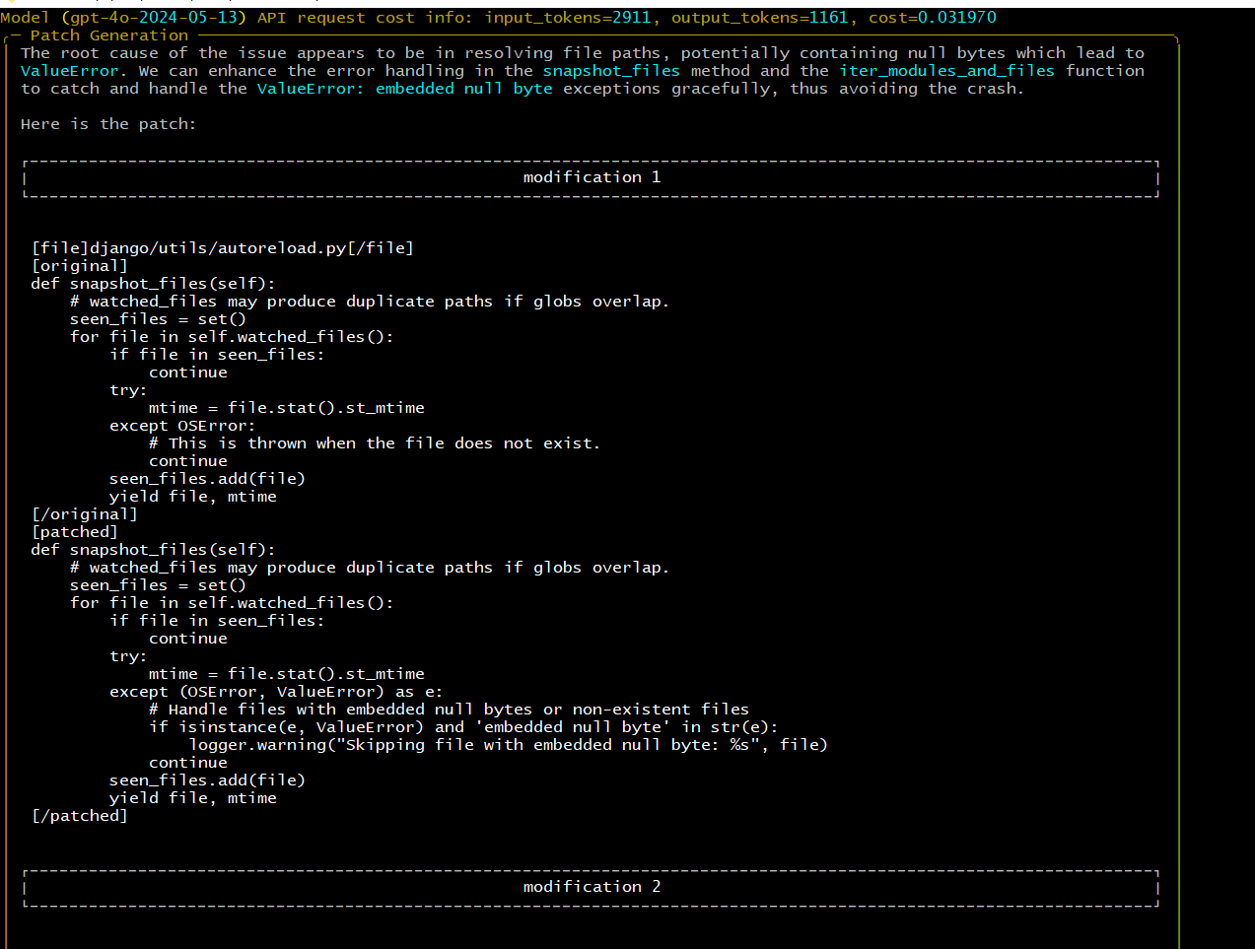

Slide 35
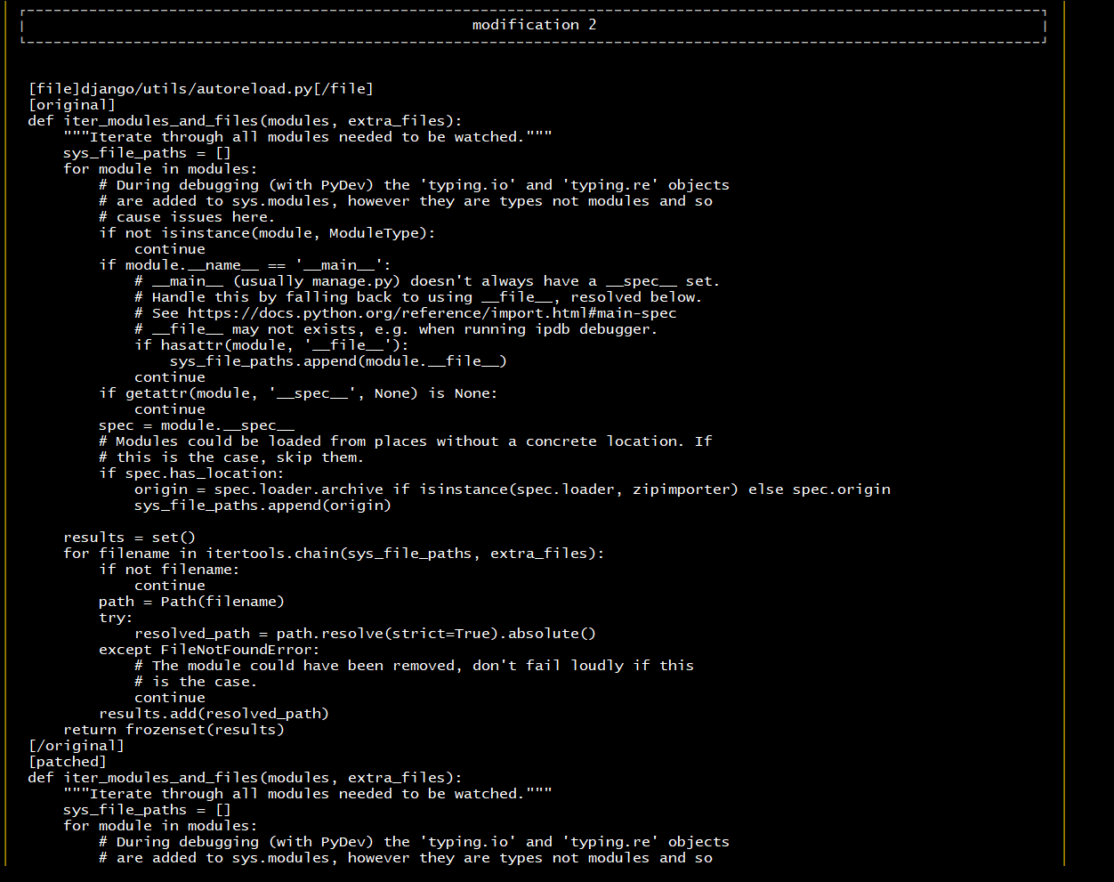

Slide 36
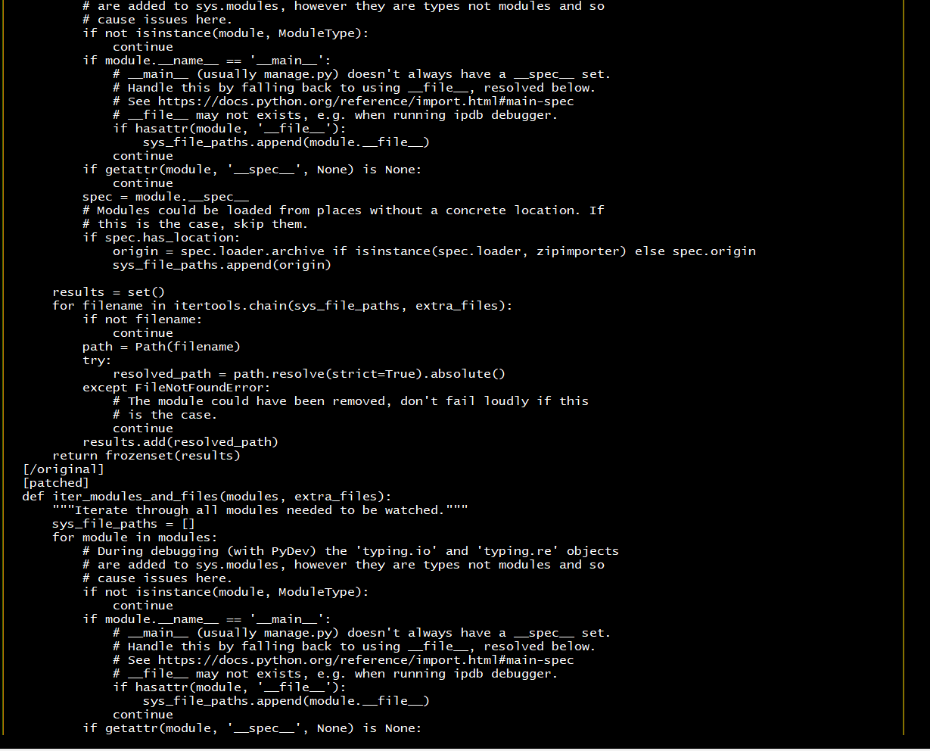

Slide 37
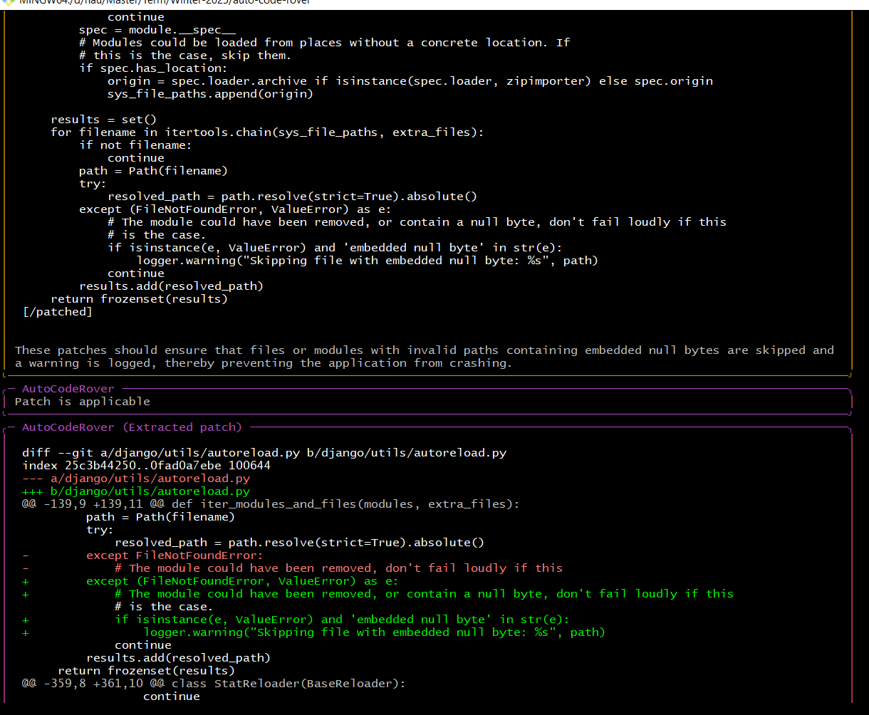

Slide 38
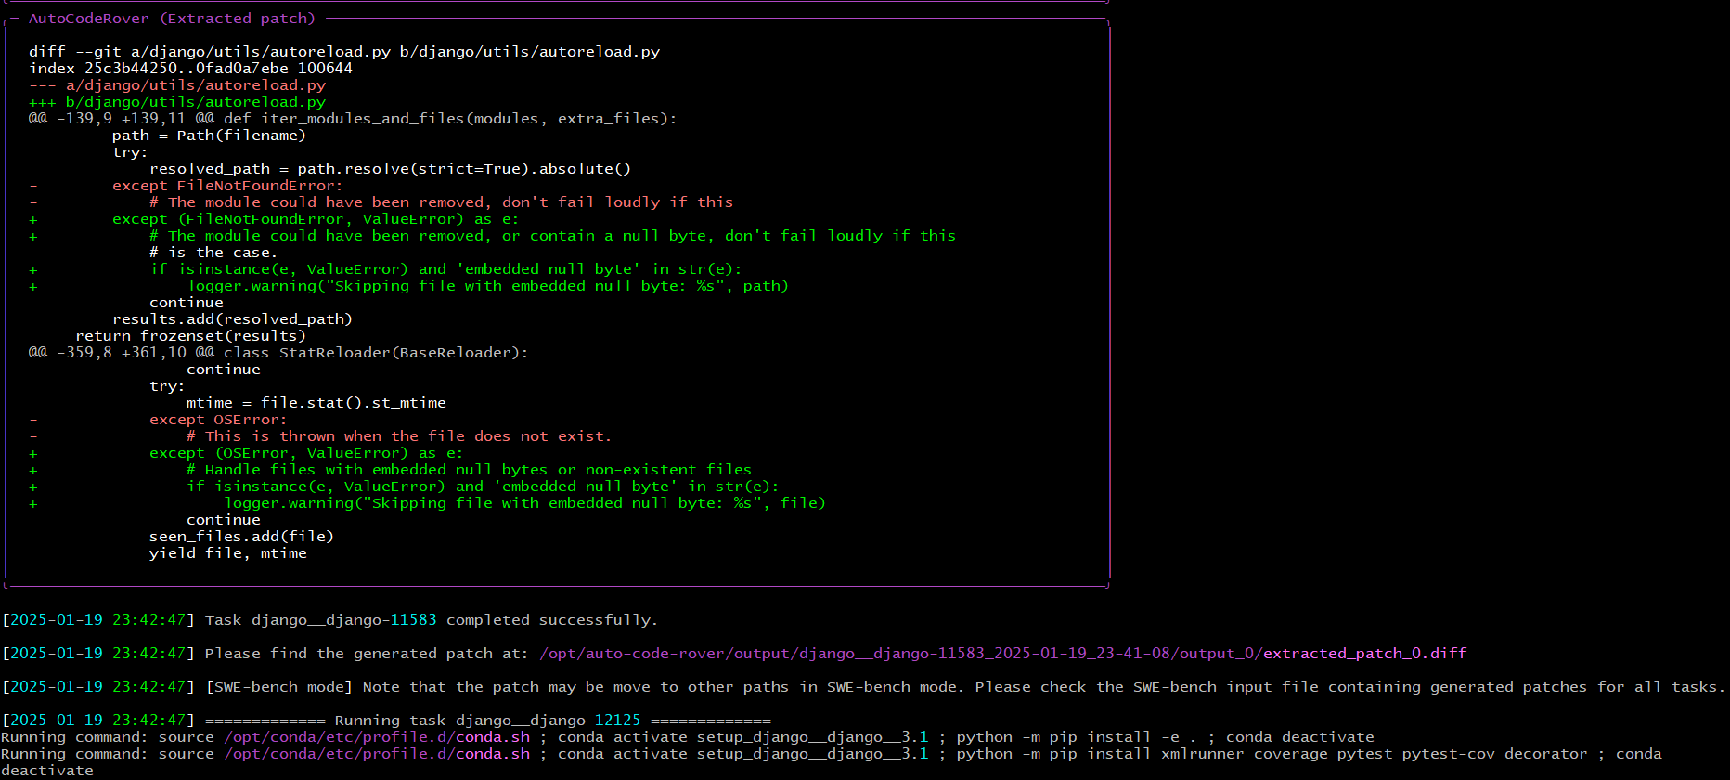

Slide 39
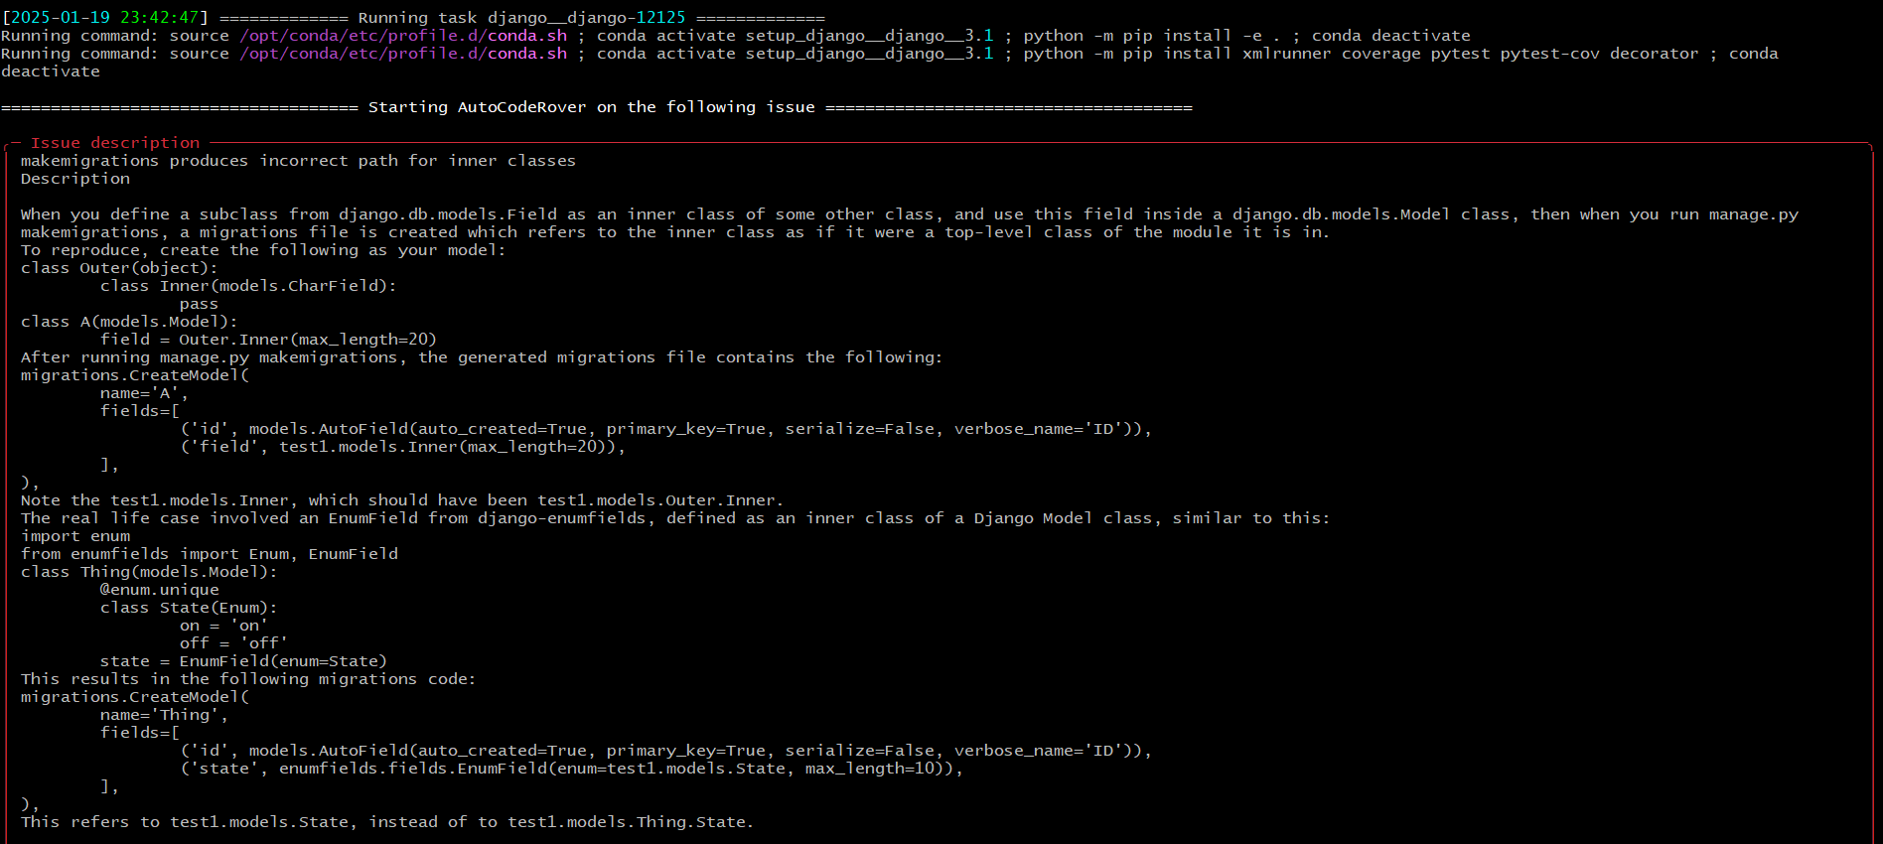
Issue 2: django-12125

Slide 40
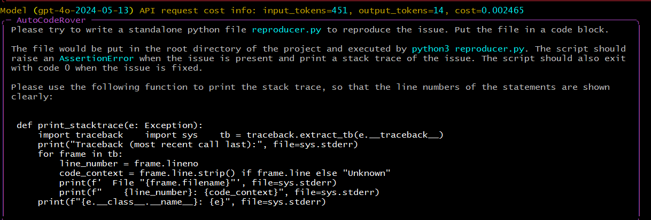
Issue 2: django-12125

Slide 41
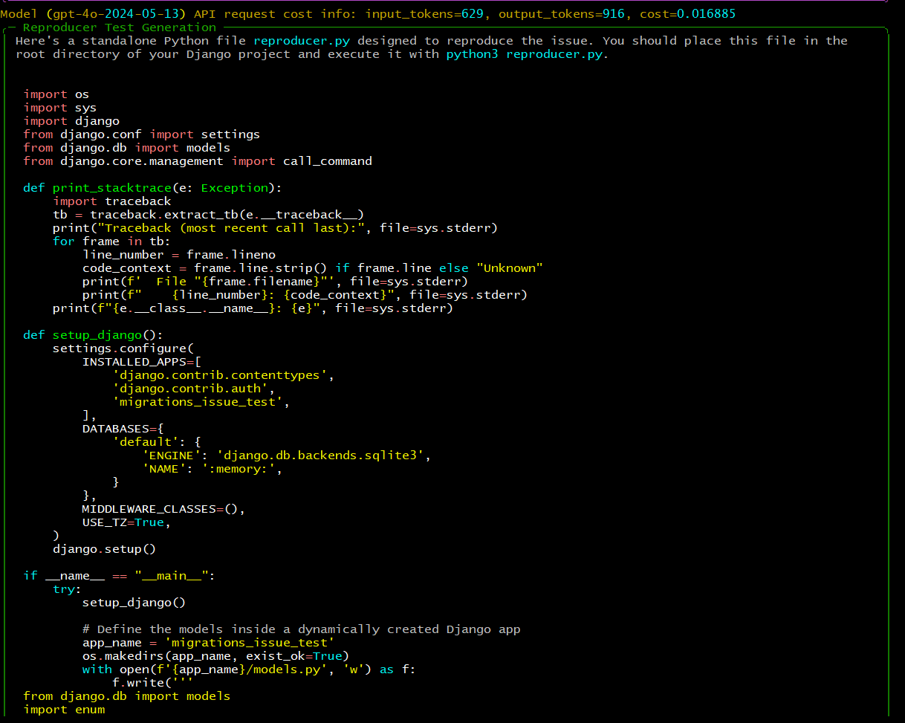

Slide 42
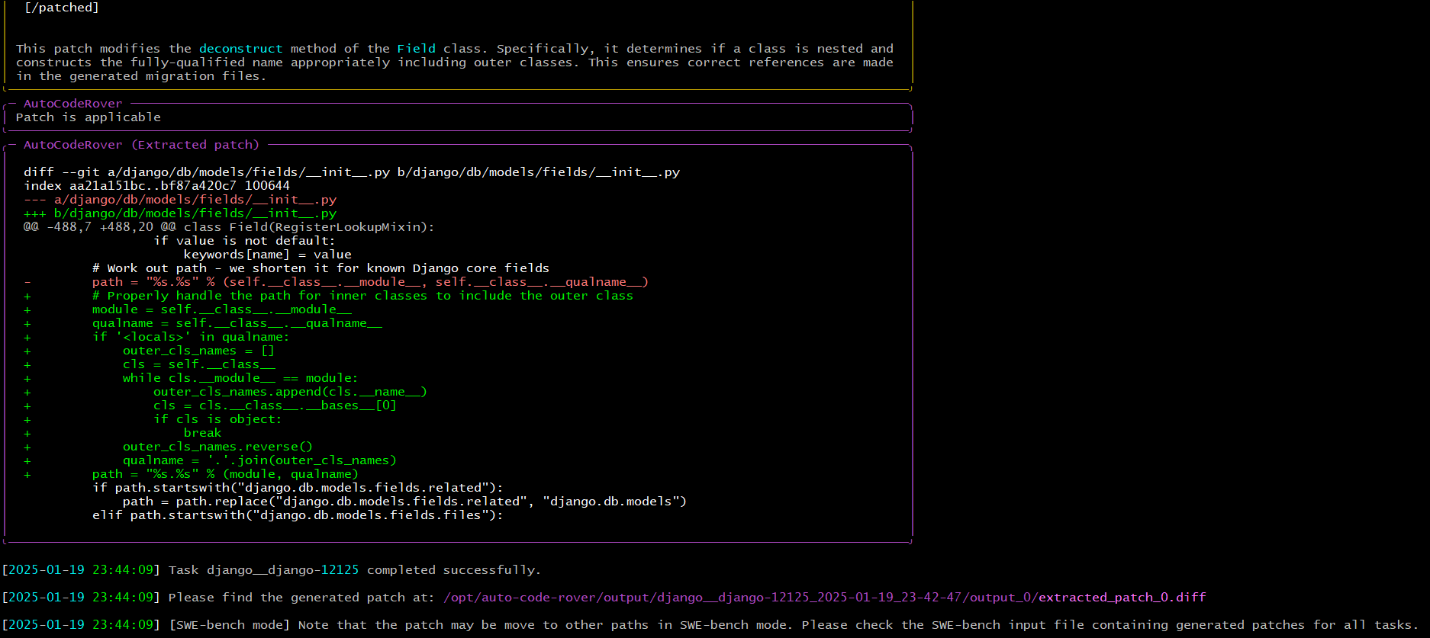

Slide 43
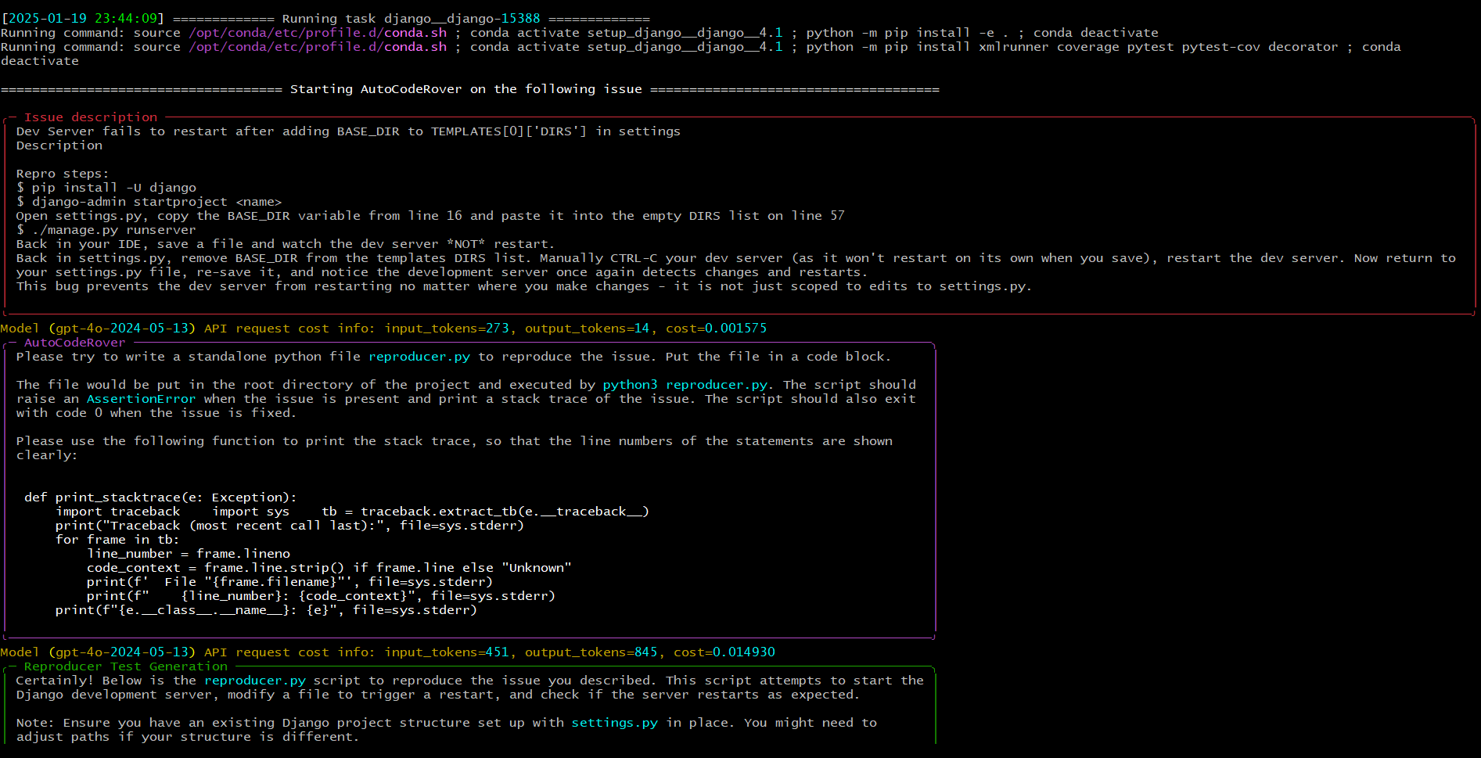
Issue 3: django-15388

Slide 44
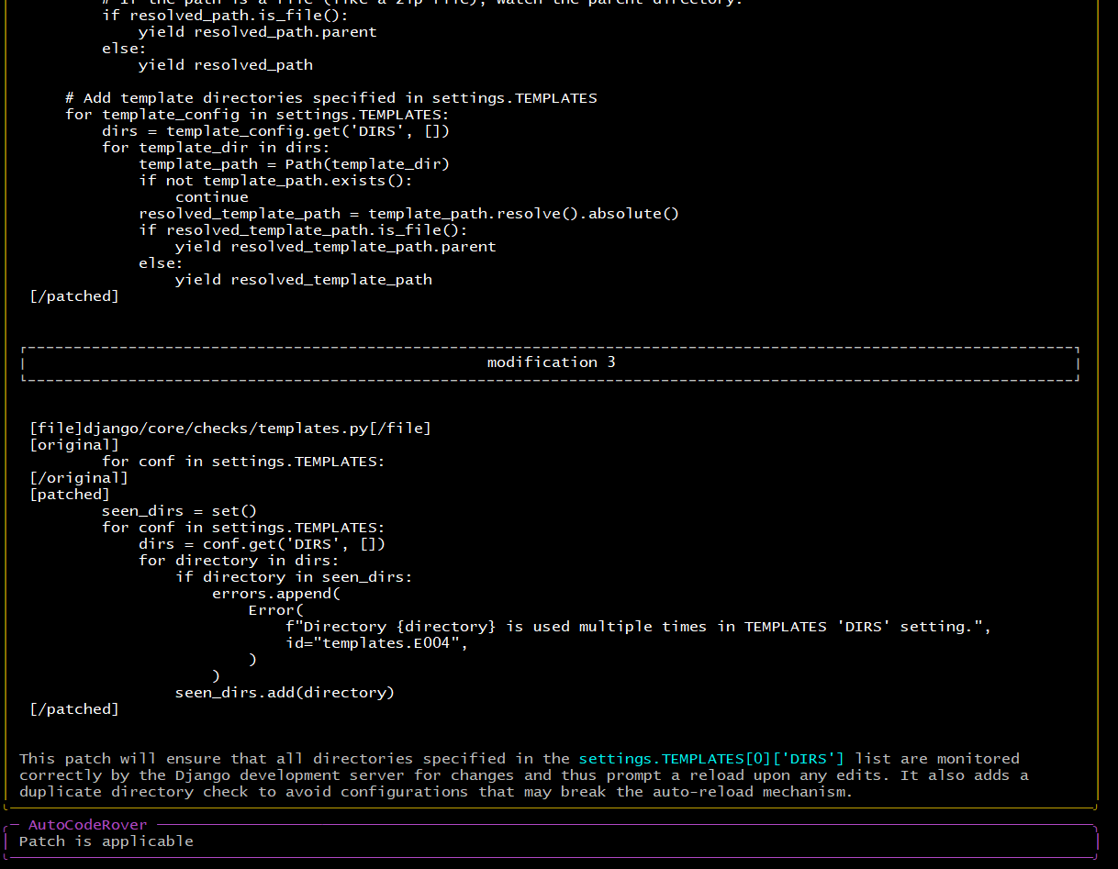
Issue 3: django-15388

Slide 45
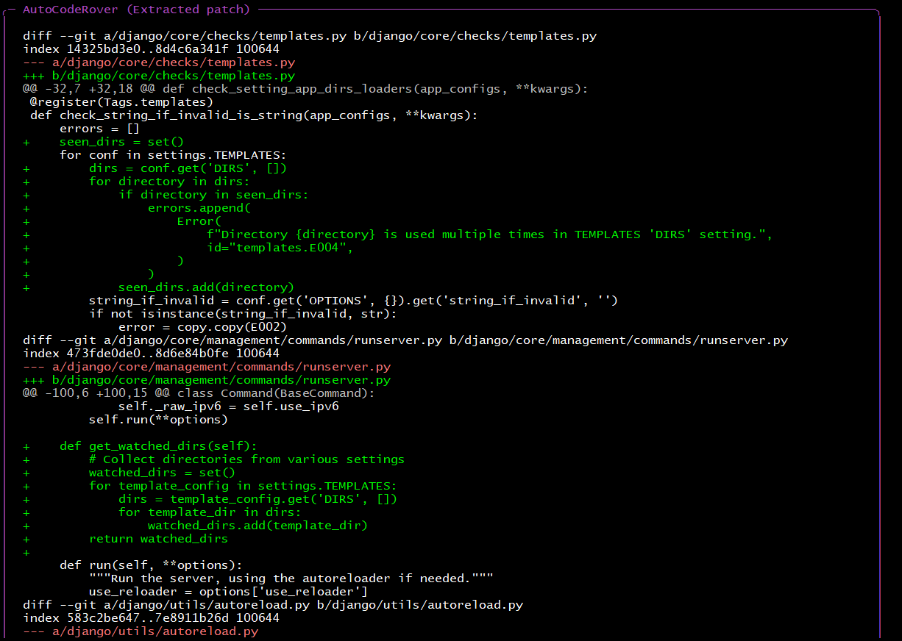
Issue 3: django-15388

Slide 46
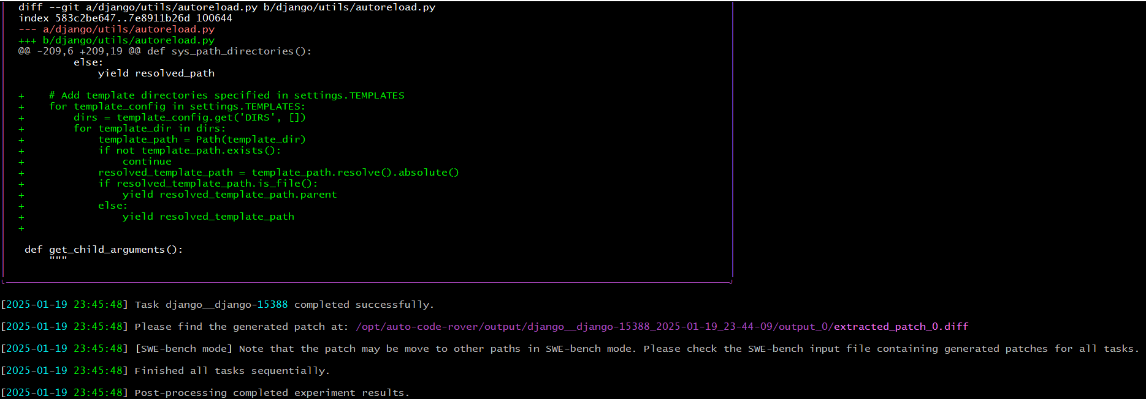
Issue 3: django-15388

Slide 47
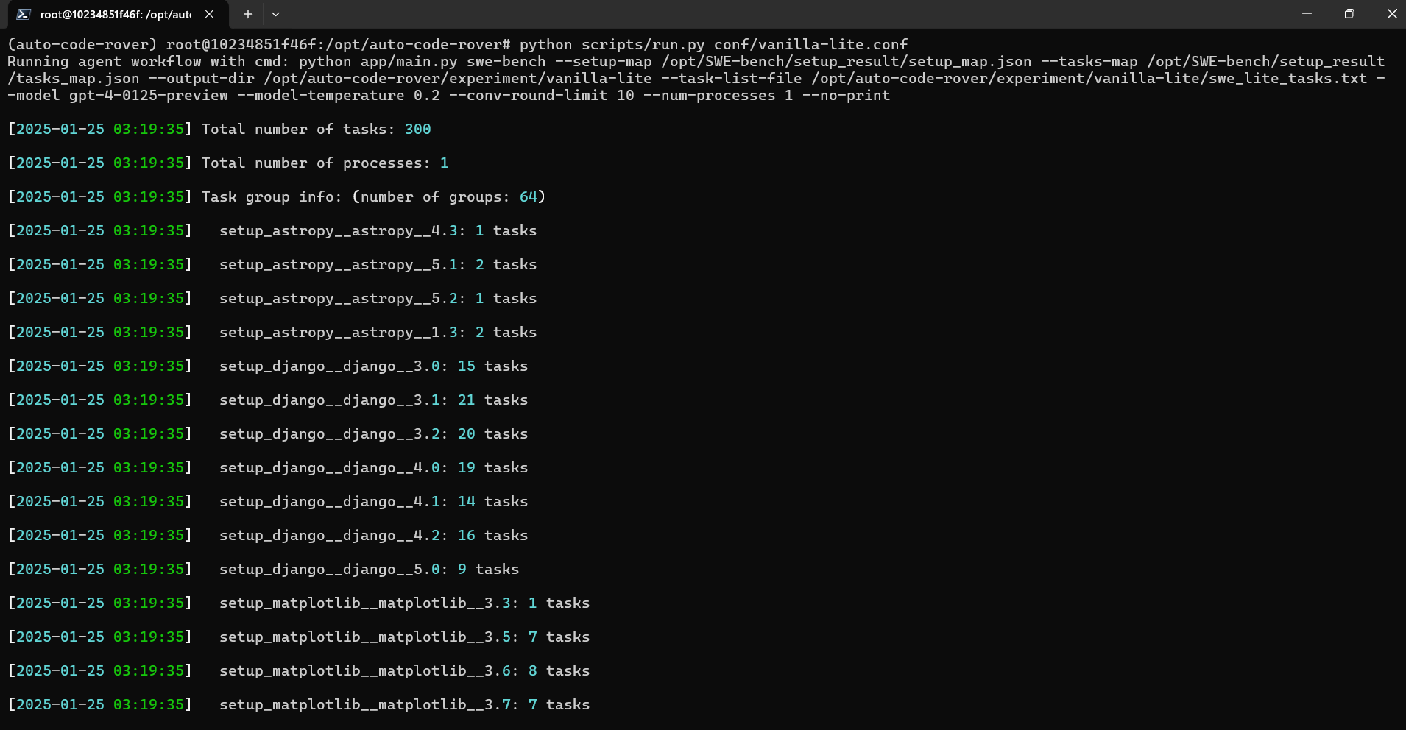
300 SWE-bench_Lite tasks

Slide 48
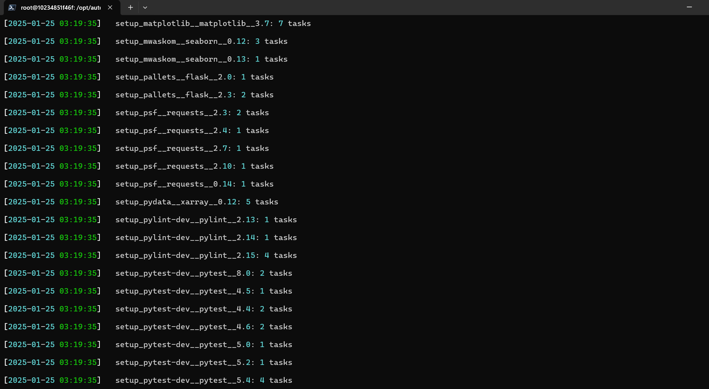
300 SWE-bench_Lite tasks

Slide 49
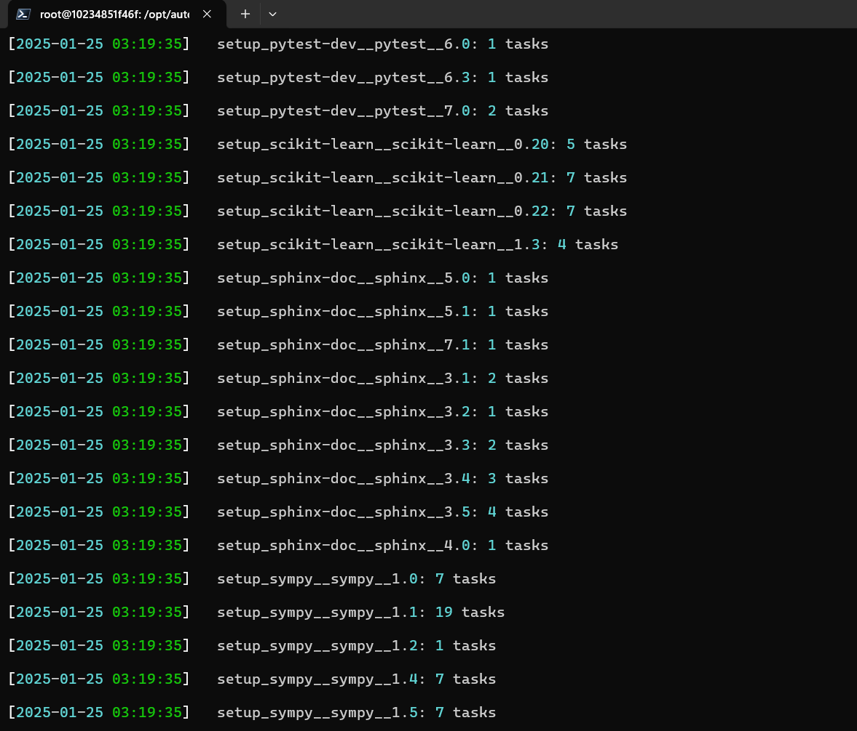
300 SWE-bench_Lite tasks

Slide 50
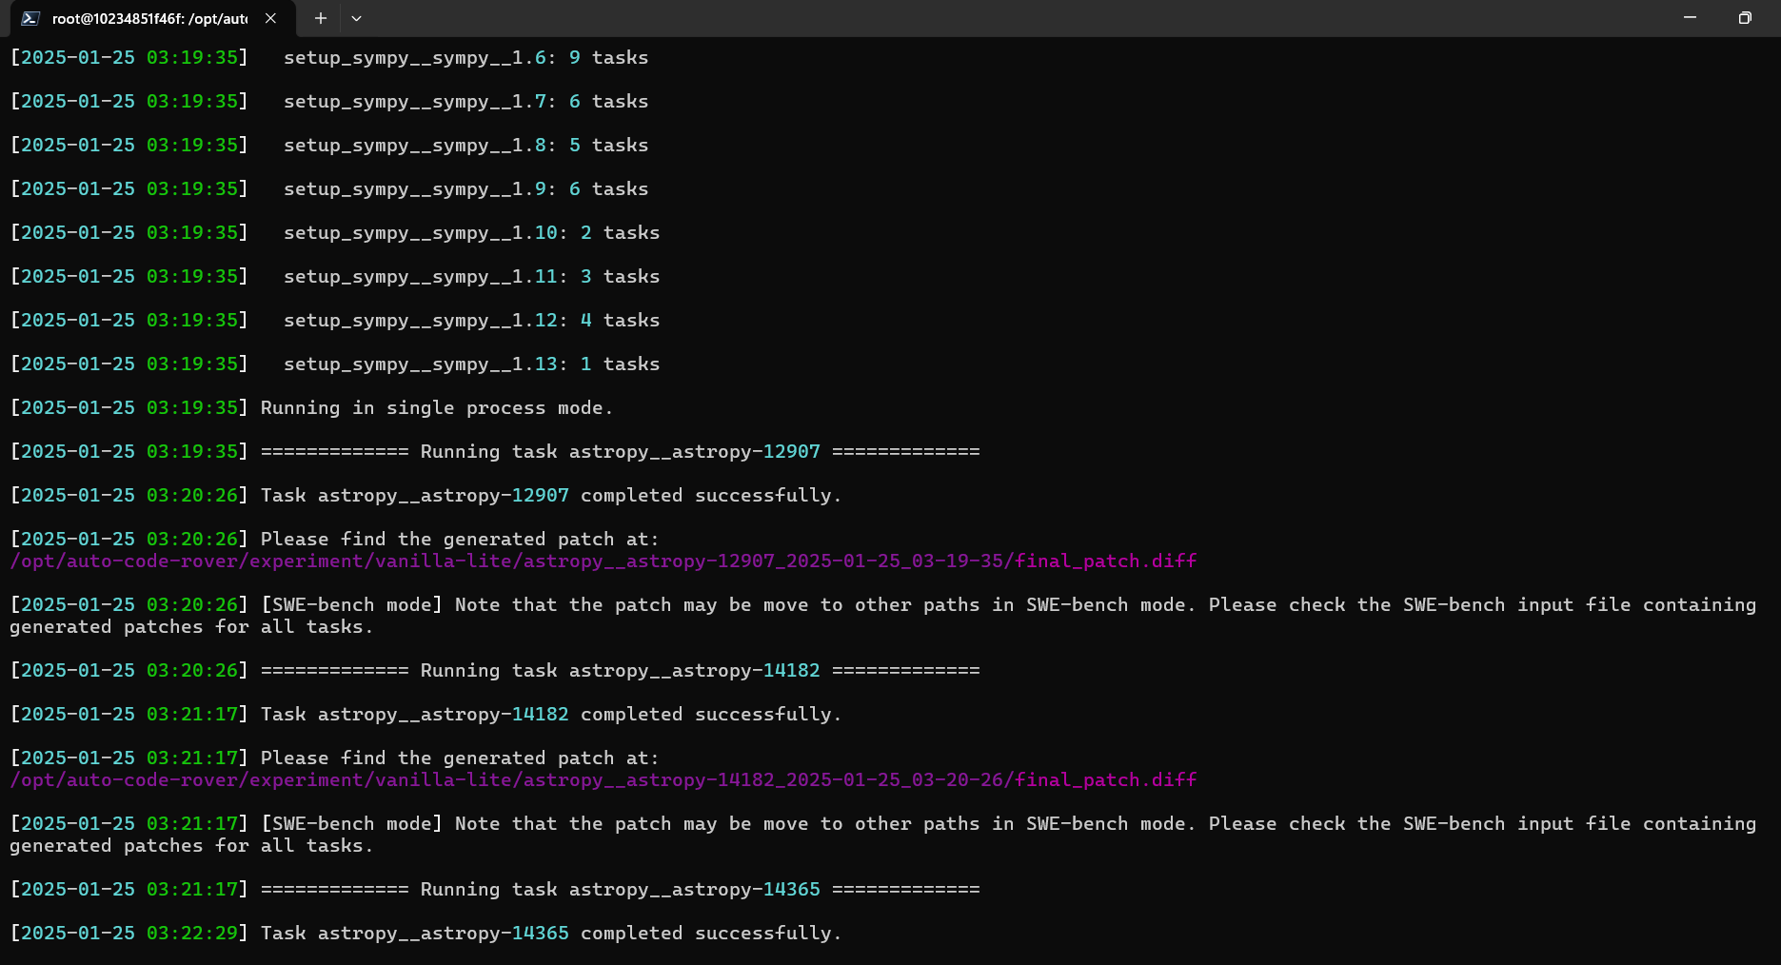
300 SWE-bench_Lite tasks

Slide 51
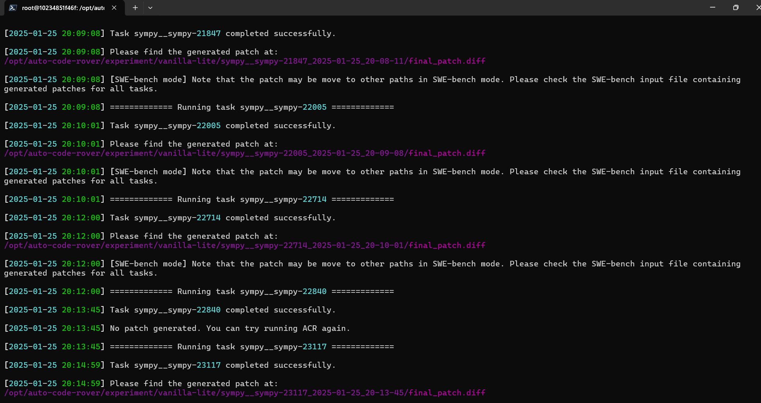
300 SWE-bench_Lite tasks

Slide 52

300 SWE-bench_Lite tasks

Slide 53
Thank you!
Questions?

Slide 54
References
AutoCodeRover: https://arxiv.org/abs/2404.05427
AutoCodeRover’s Github: https://github.com/AutoCodeRoverSG/auto-code-rover
SWE-bench: https://www.swebench.com/

